Slide 1



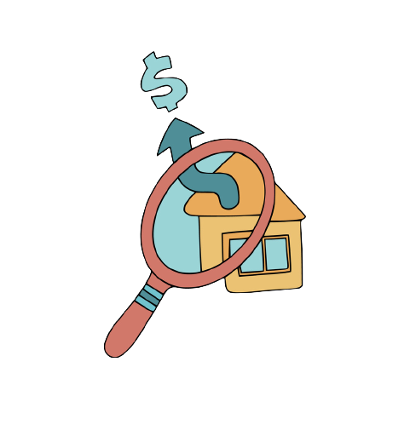



Home Energy Audit
Presentation by Ghahramanyan Kristina
American University of Armenia
Course: ENV 150 Basics of Sustainable Energy
Astghine Pasoyan, Norayr Benohanian
Date: April 13, 2021

Slide 2

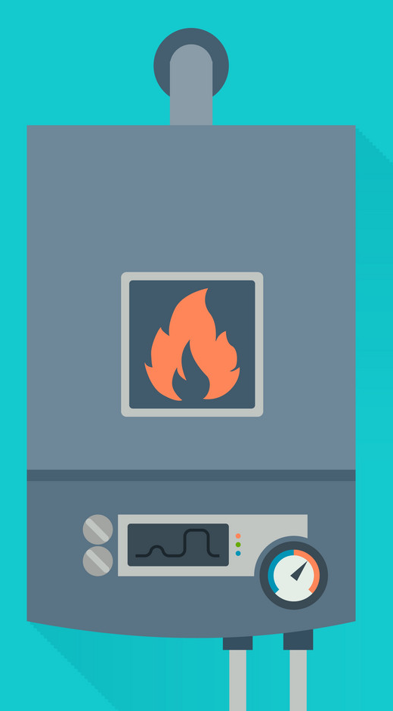

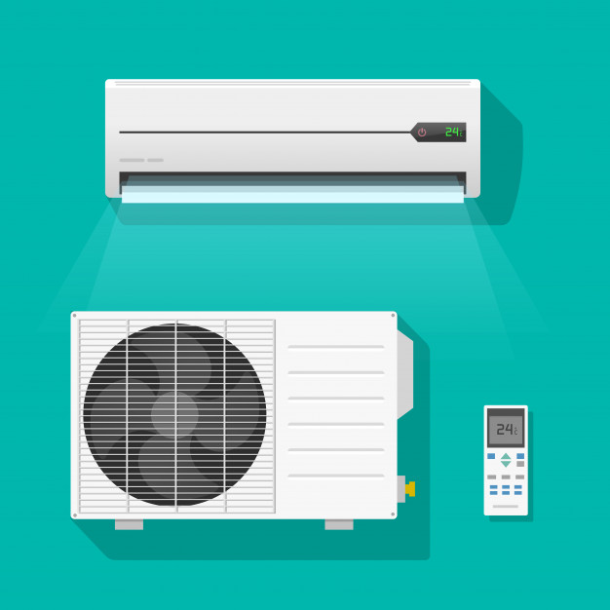
Goals
Summarize the energy usage of the apartment
Identify the most prominent causes of energy lose
Suggest solutions for minimizing the loses
2

Slide 3

Energy used for lighting
1
The most pressing issue with lighting emerges from using 24 incandescent lightbulbs in the apartment. This problem happened due to a mistake which was done during the renovation. Currently, no other lightbulbs work in most of the rooms in the house. This requires immediate change because those lightbulbs are turned on for at least 8 hours during the day, which leads to a huge energy loss. Also, fixing this electrical issue will allow us to use sensors for lighting and that will save even more electricity.
3

Slide 4
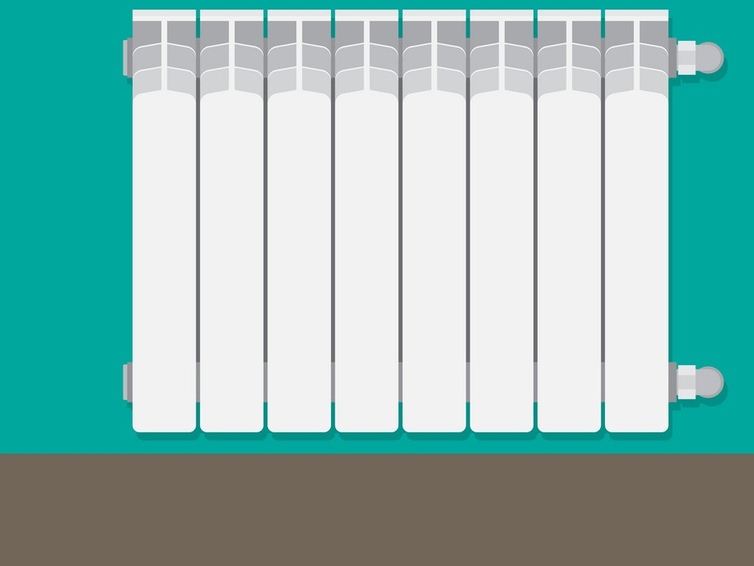
2
Energy used for heating
The main loss of heat in the apartment happens due to a misuse of the radiators. During the winter, most of the radiators are covered by either laundry or the curtains, which makes them inefficient. This creates a closed environment, and the heat goes up immediately instead of circulating around the room.
This issue could be fixed by either moving the radiators, which would be difficult, or by simply not covering them at all. This would mean that some heat will escape through the glass of the windows, but it would not be as substantial as loosing heat because of coverage.

Slide 5

Energy used for cooling or ventilation
3
The apartment has two Air Conditioners, which are the main means for cooling during the hot season. The ACs are equipped with energy saving features, which allow them to automatically shut down when the desired temperature is reached. Yet, there is a major limitation which has affected the efficiency of one of the air conditioning units. Due to the lack of space on the exterior walls of the apartment, the AC was installed in one of the corners of the room. This has made the air flow inefficient because the shape of the room does not allow the air to circulate throughout the whole area.
To fix this issue, the AC unit must be moved from the corner, or an alternative method of cooling should be used instead.
As a different appliance, we can use a swamp cooler, which could end up being more beneficial. They are advantageous because they: humidify the air, generate less noise, are easy to maintain.

Slide 6
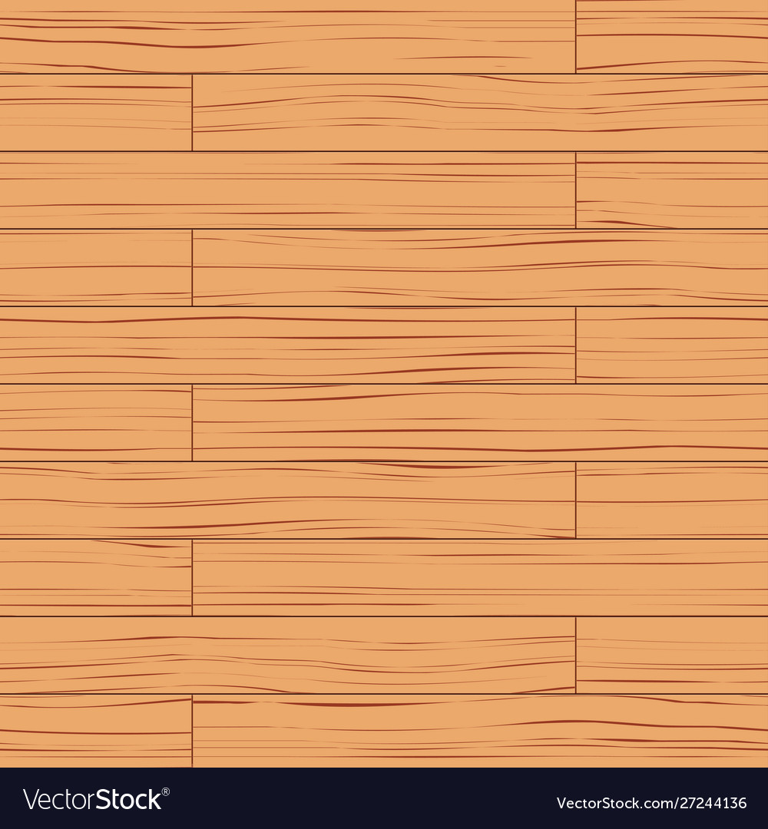
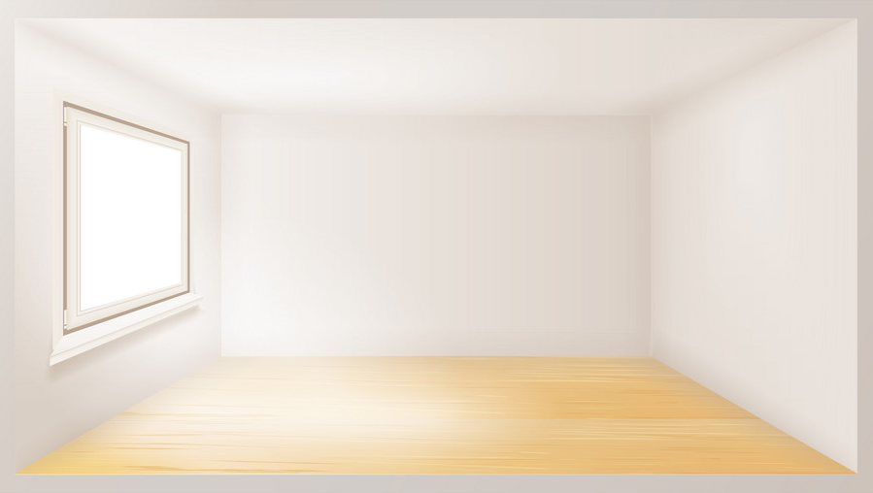
Calculations before adding any insulation
Floor | Thickness | Thermal Conductivity (W/m²k) | R | U-value
Concrete | 0.5 | 1.7 | 0.29 | 2.56
Fiber hardboard | 0.02 | 0.2 | 0.1
Ceiling | Thickness | Thermal Conductivity (W/m²k) | R | U-value
Concrete | 0.5 | 1.7 | 0.29 | 3.44
Walls | Thickness | Thermal Conductivity (W/m²k) | R | U-value
Concrete | 0.35 | 1.7 | 0.2 | 5

Slide 7

For the ceiling, I have chosen to use polyurethane foam boards, as they provide both structural support and good insulating properties. The boards are specifically important, because the foam spray would not be beneficial to install as insulation for the ceiling, because we do not have a roof to compensate for the uneven shape of the hardened material.
For the walls, I believe the best material would be non-woven basalt mat. This insulating material eliminates diffused water vapor creation inside the walls. It is also quite beneficial due to its compactness.
For the floors, I think the most optimal choice would be to use expanded polystyrene (EPS). Among other rigid-foam materials, EPS preforms better in the long-term use, which I consider important for our case (as the building is not going to be deconstructed any time soon). It is also the cheapest one if we compare it to XPS or ISO.
7

Slide 8
Calculations after adding insulation
Ceiling | Thickness | Thermal Conductivity (W/m²k) | R | U-value
Concrete | 0.5 | 1.7 | 0.29 | 0.473
Polyurethane foam boards | 0.04 | 0,022 | 1.82
Floor | Thickness | Thermal Conductivity (W/m²k) | R | U-value
Concrete | 0.5 | 1.7 | 0.29 | 0.446
Fiber hardboard | 0.02 | 0.3 | 0.07
Wool carpet | 0.015 | 0.6 | 0.025
Expanded polystyrene (EPS) | 0.065 | 0.035 | 1.857
Walls | Thickness | Thermal Conductivity (W/m²k) | R | U-value
Concrete | 0.35 | 1.7 | 0.2 | 0.467
Non-woven basalt mat | 0.06 | 0.031 | 1.94

Slide 9

Thank You!

